Slide 1
Project Website for Lenovo
Group Member:
SALIHAH
NUR NADirah
ERMI HASNURSHILA
Muzammil Muhammad

Slide 2
Lenovo Web Page Manual
Suitable for Mozilla Firefox

Slide 3
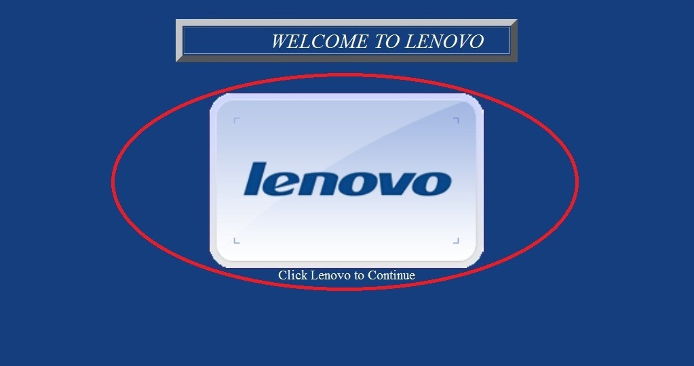
Welcome Interface
1(a)
Description
This web page is to welcome the user. This page also have background music.
1(a): link to MAIN MENU.

Slide 4
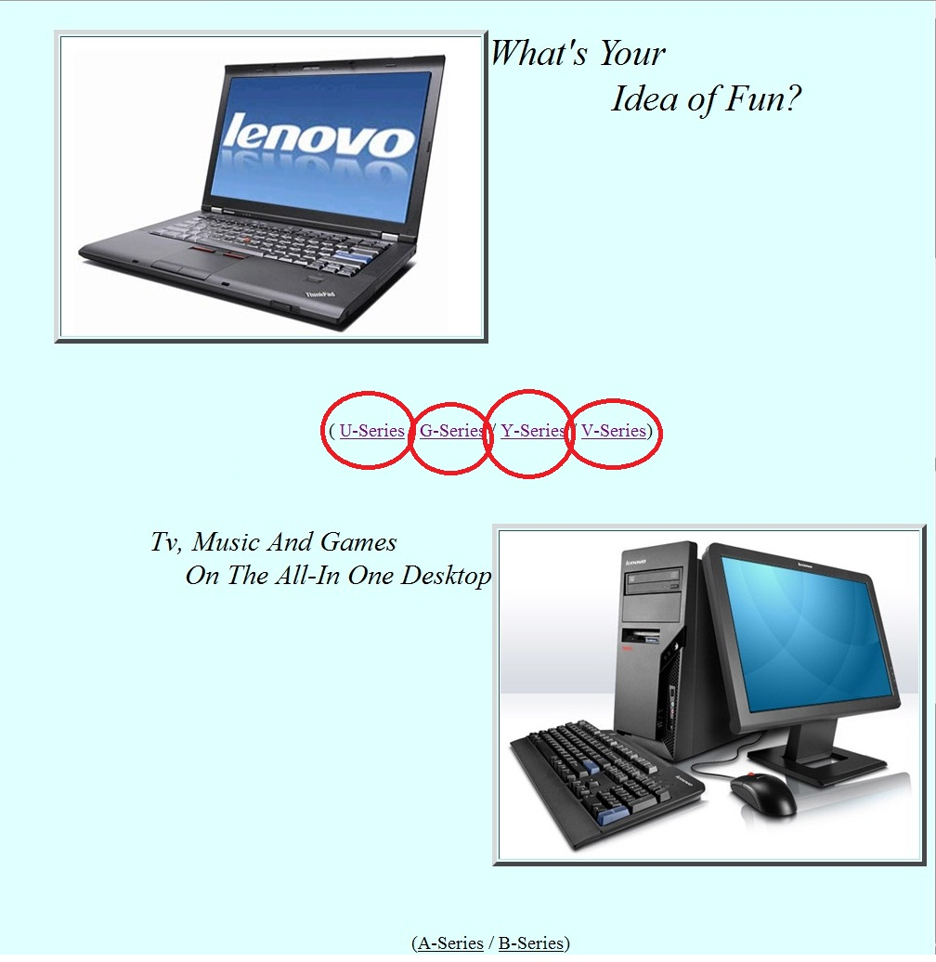
MAIN MENU Interface
2(c)
2(d)
2(a)
2(b)
Description
This web page is Main Menu. This page will link to product interface.
2(a): link to U series product.
2(b): link to G series product.
2(c): link to Y series product.
2(d): link to V series product.

Slide 5
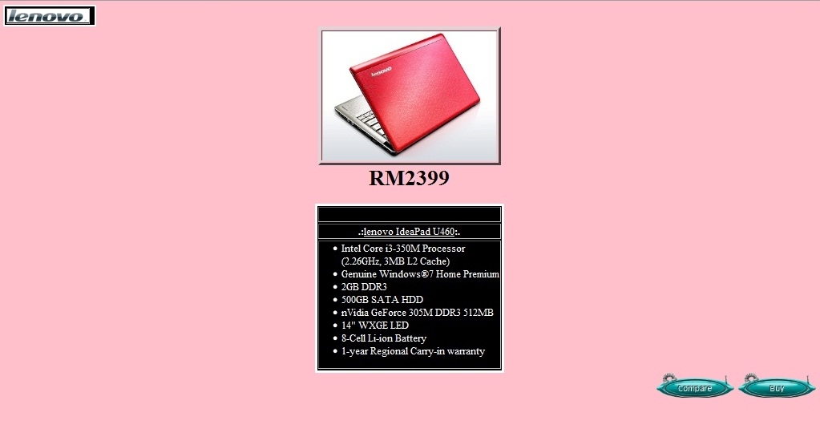
Product Interface
3(a)
3(c)
3(b)
Description
This web page is about product detail. From this page we can return to Main Menu and also have button.
3(a): click Logo Lenovo to return Main Menu.
3(b): click button to compare product.
3(c): click to buy product.

Slide 6
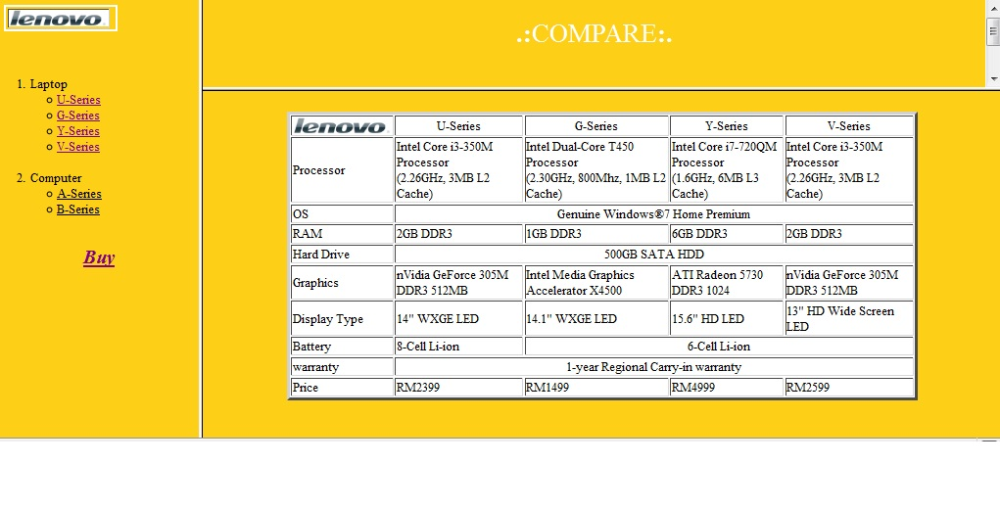
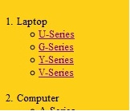
Compare Interface
4(a)
4(c )
4(b)
4(d)
4(g)
4(e)
4(f)
Description
Here you can compare the product. From this page we can return to Main Menu <4(a)> and Sub menu <4(b)> on the side of web page. In this Page also have link to buy product <4(g)>.
4(c): link to U series product.
4(d): link to G series product.
4(e): link to Y series product
4(f): link to V series product.

Slide 7
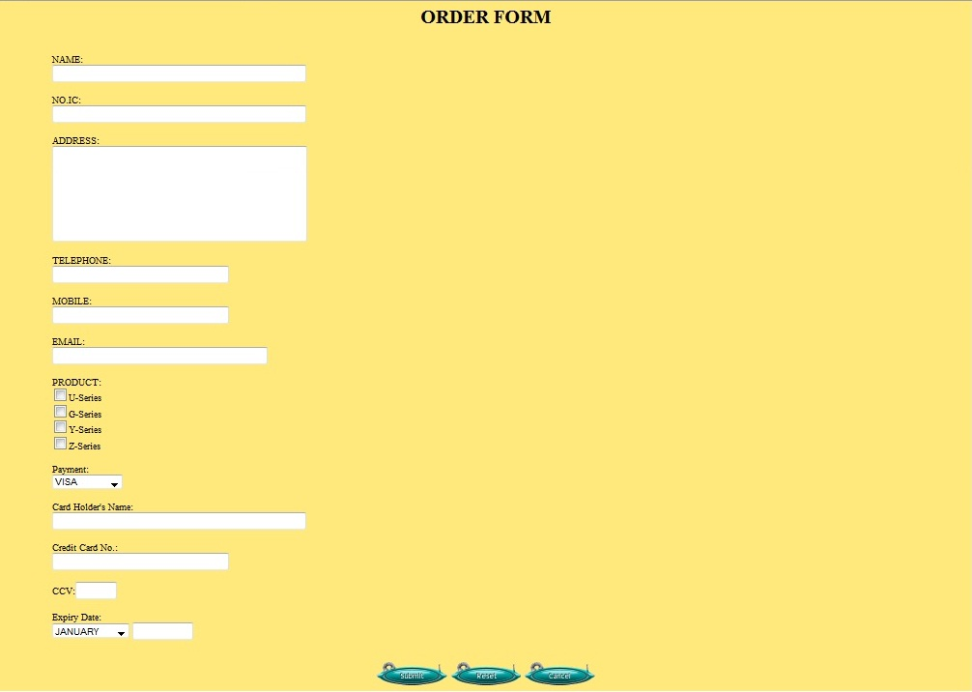


Order Form Interface
5(a)
5(c)
5(b)
5(d)
5(e)
Description
User must fill the form to complete their order. 5(a) is type of payment and 5(b) is month for expiry date using select.
5(c): click to Submit.
5(d): click to Re-fill the form.
5(e): click to Cancel.

Slide 8
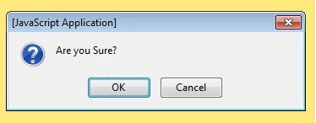
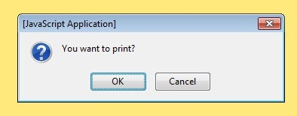
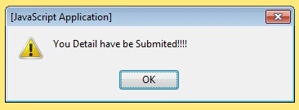
Pop-up
6(a)
6(b)
Description
This Pop-up will pop when click submit button in order form.
6(a): click to open your email app.(see 9(a)) for sent information that have been fill.
6(b): click to Re-fill the form .
Description
This Pop-up will pop after click button 6(a). This pop-up will ask for print.
7(a): click to print.
7(b): click to skip print.
7(b)
7(a)
8(a)
Description
This Pop-up will pop after click button 7(a) or 7(b) .
7(a): click to return back to main menu.

Slide 9
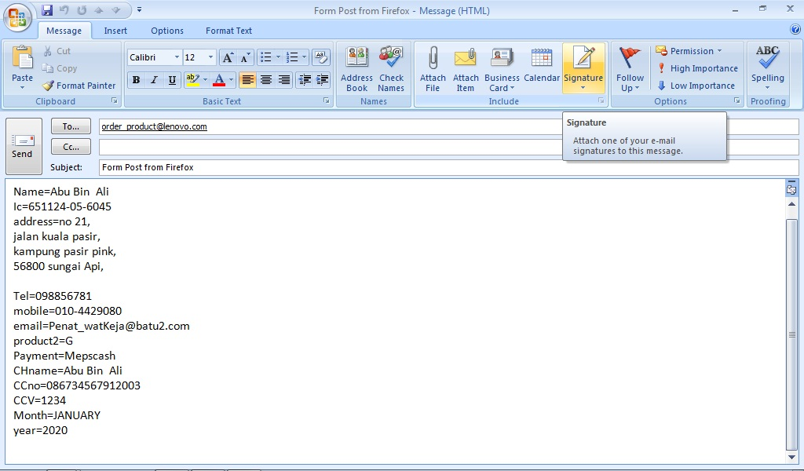
Email Application
9(a)

Slide 10
Thank you…..
For Your Attention…….

